Slide 1




Crop and Fertilizer Recommendation System using Machine Learning

Slide 2

Learning Objectives
Understand the role of machine learning in optimizing fertilizer recommendations.
Learn how to process and analyze agricultural data, including soil composition and crop types.
Apply classification algorithms (Decision Tree) for predictive analysis.
Improve decision-making for farmers by providing real-time fertilizer recommendations.
GOAL
Source :
www.freepik.com/

Slide 3
Tools and Technology used
Programming Language: Python
Libraries:
NumPy, Pandas – Data manipulation
Matplotlib, Seaborn – Data visualization
Scikit-learn – Machine Learning models, preprocessing, and evaluation
Preprocessing Techniques:
Handling missing values and duplicates
Encoding categorical features (soil types, crop names)
Feature scaling using StandardScaler
Machine Learning Models:
Decision Tree Classifier
Model evaluation using accuracy metrics

Slide 4
Methodology
Step 1: Data Preprocessing & Exploration
Loaded datasets:
Crop_recommendation.csv
Fertilizer Prediction.csv
Exploratory Data Analysis (EDA):
Checked data types, distributions, missing values, and duplicates.
Used heatmaps & correlation analysis to identify key relationships.
Segmented numerical and categorical features.
Step 2: Feature Engineering
For Crop Recommendation:
Key factors: Nitrogen, Phosphorus, Potassium, Temperature, Humidity, Rainfall, pH.
Labelled crops numerically for classification models.
For Fertilizer Recommendation:
Features: Soil Type, Crop Type, Moisture, Temperature, Humidity, NPK values.
Used Label Encoding to convert text categories into numeric values.

Slide 5
Step 3: Data Splitting & Scaling
Separated X (features) and Y (target variables).
Split data into training (80%) and testing (20%) sets.
Applied StandardScaler to normalize numeric data.
Step 4: Model Training & Evaluation
Crop Recommendation Model:
Used Decision Tree Classifier.
Achieved 100% accuracy (indicating possible overfitting).
Fertilizer Recommendation Model:
Used Decision Tree Classifier.
Achieved 100% accuracy (indicating possible overfitting).
Step 5: Predictive
Built a recommendation function to:
Accept input parameters (e.g., soil type, crop type, weather, NPK).
Predict best crop & fertilizer

Slide 6
Problem Statement:
Farmers lack precise recommendations for which crops to grow and what fertilizers to use.
Overuse/misuse of fertilizers leads to soil degradation and environmental harm.
Traditional farming relies on intuition rather than data-driven decision-making.

Slide 7
Solution:
Machine Learning-powered advisory system for farmers.
Crop Recommendation System based on soil nutrients & climate conditions.
Fertilizer Recommendation System for optimal soil enrichment.

Slide 8
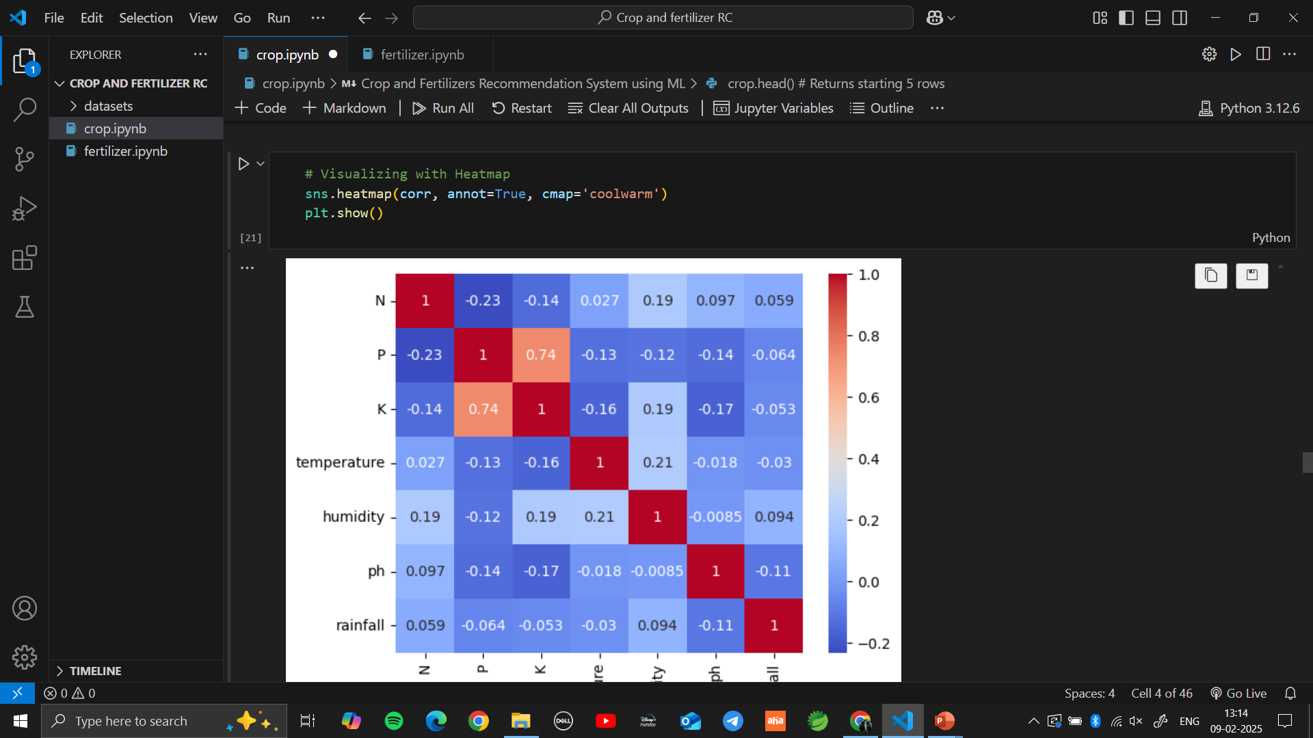
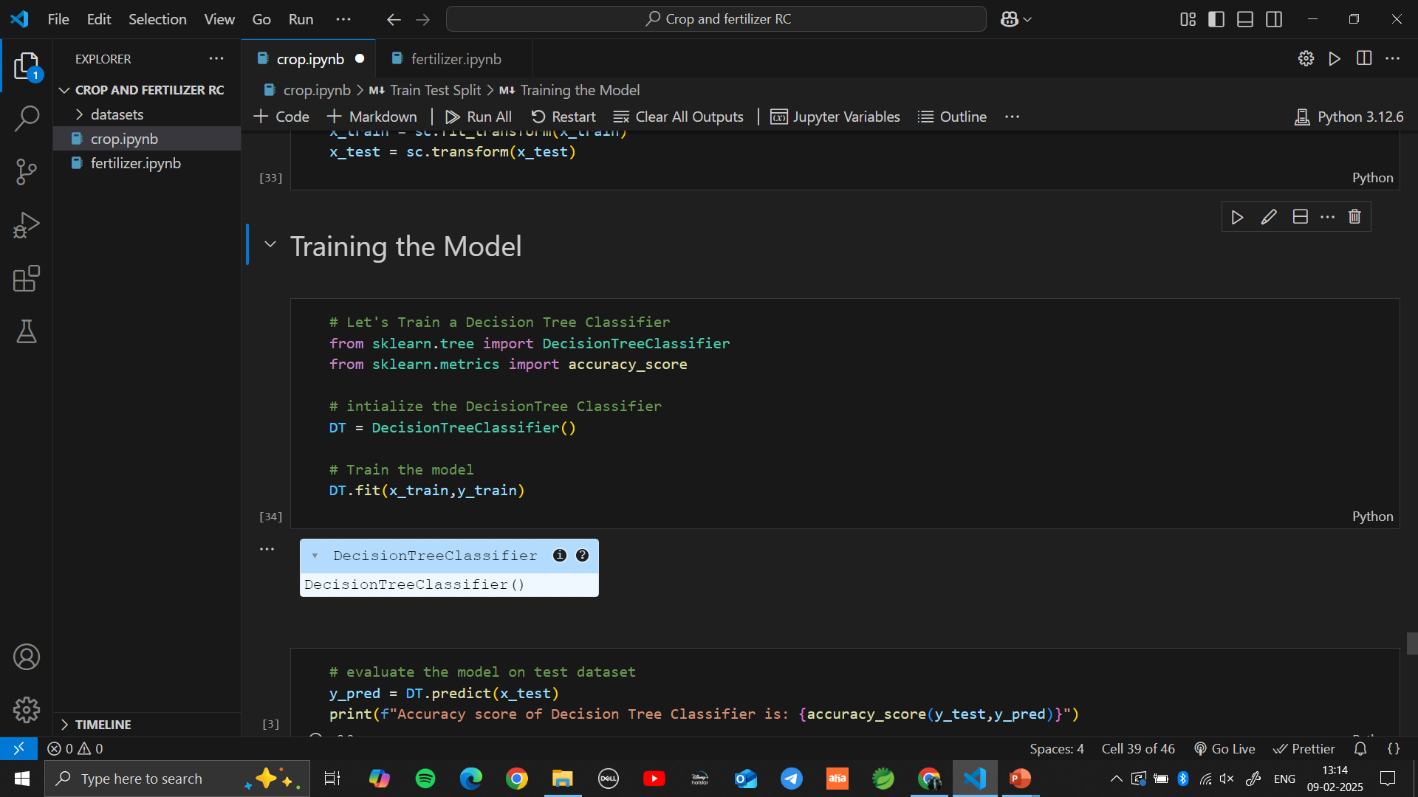
Screenshot of Output:
Crop Recommendation System:
CORELATION
DecisionTreeClassifier()

Slide 9
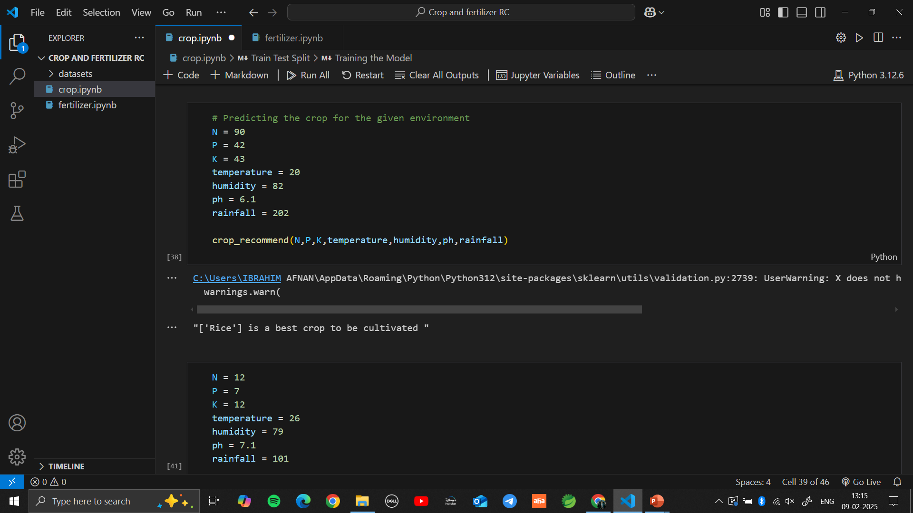
CROP RECOMMENDATION SYSTEM OUTPUT:

Slide 10
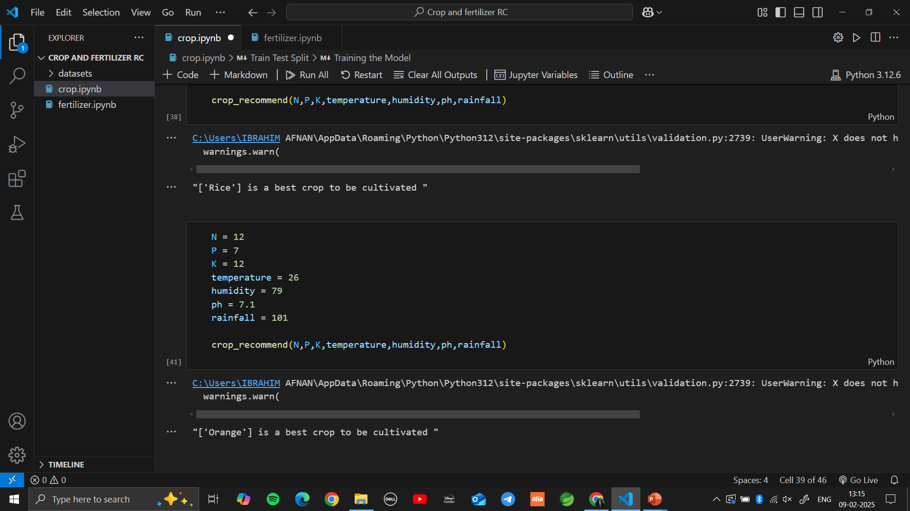

Slide 11
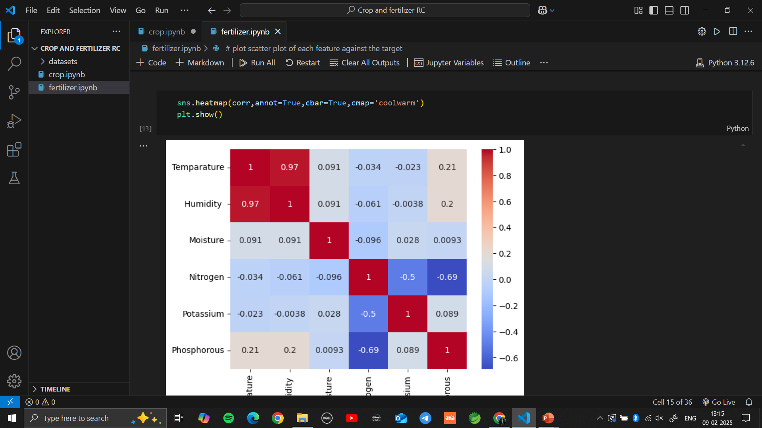
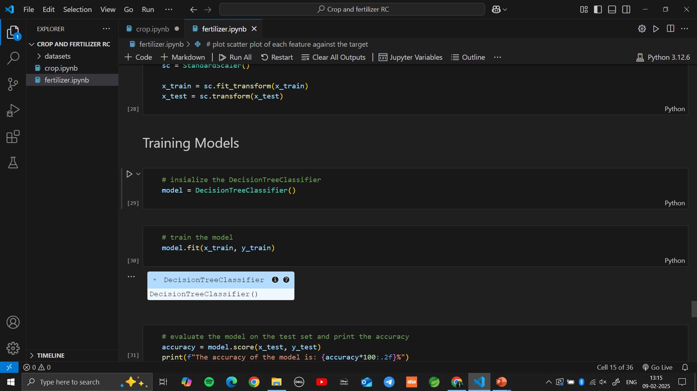
Fertilizer Recommendation System:
CORELATION
DecisionTreeClassifier()

Slide 12
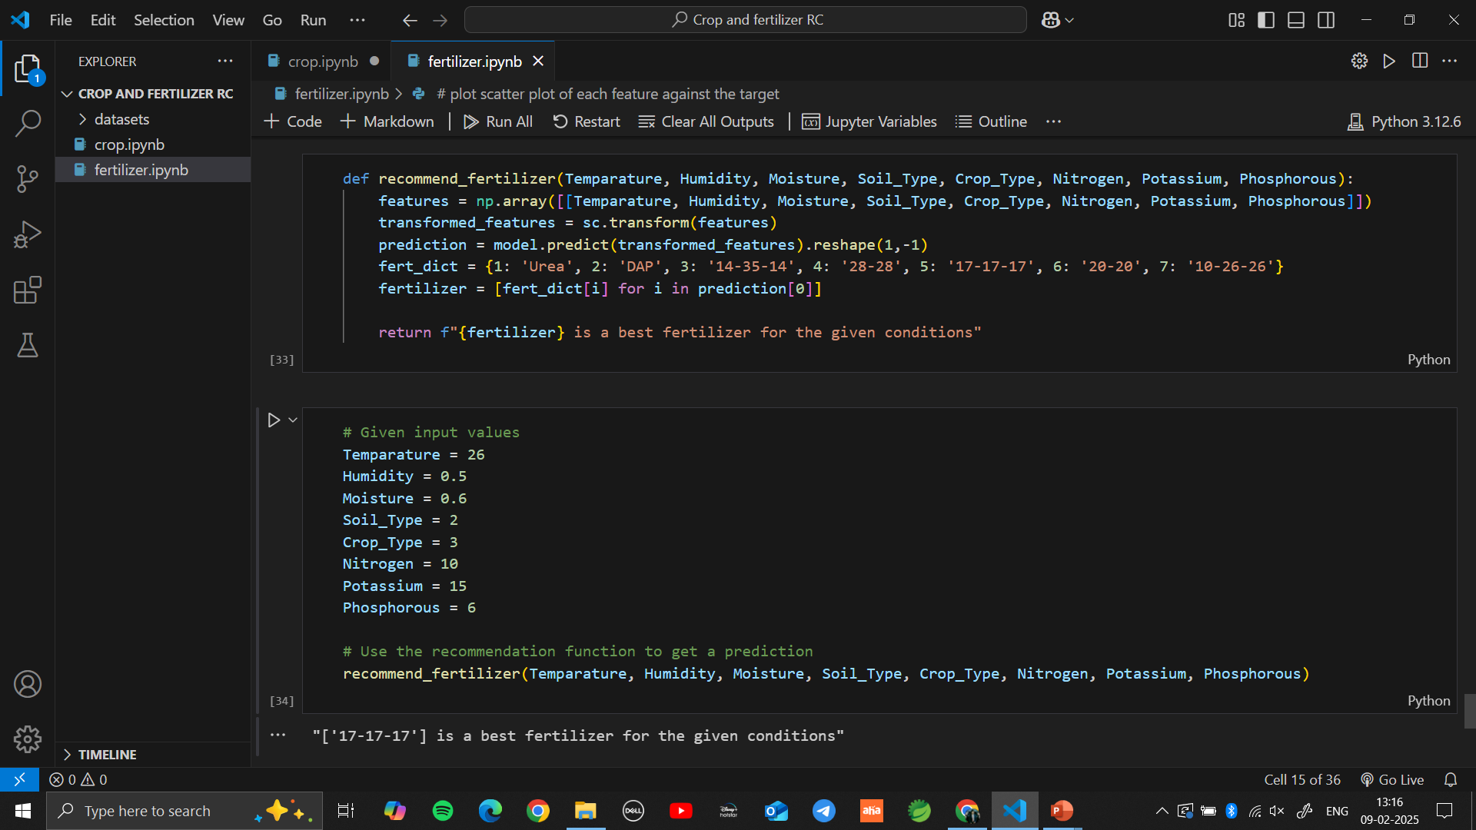
FERTILIZER RECOMMENDATION SYSTEM OUTPUT:

Slide 13
Conclusion:
The Crop and Fertilizer Recommendation System leverages machine learning to enhance agricultural productivity by providing data-driven recommendations for optimal crop selection and fertilizer use. Through data preprocessing, feature engineering, and predictive modeling, the system ensures that farmers make scientific and informed decisions rather than relying on traditional trial-and-error methods.
Key Takeaways:
Improved Decision-Making: The system helps farmers select the best crop based on soil nutrients (NPK), temperature, humidity, and rainfall. It also suggests the right fertilizer for soil enrichment.
Efficient Resource Utilization: Reduces overuse of fertilizers, preventing soil degradation and environmental harm.
High Model Accuracy: Machine learning model like Decision Trees improve prediction accuracy.
Scalability & Future Integration: The system can integrate real-time weather data and be deployed as a mobile or web application for wider accessibility.

